Slide 1
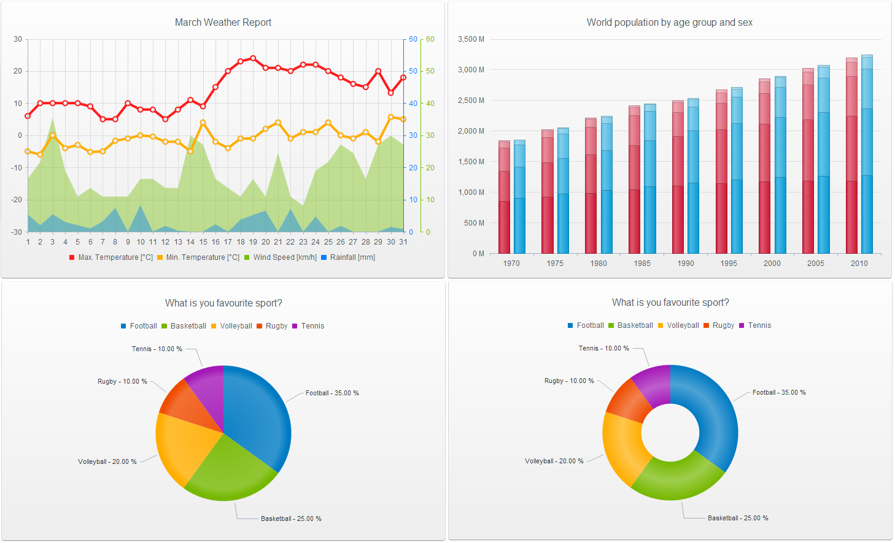

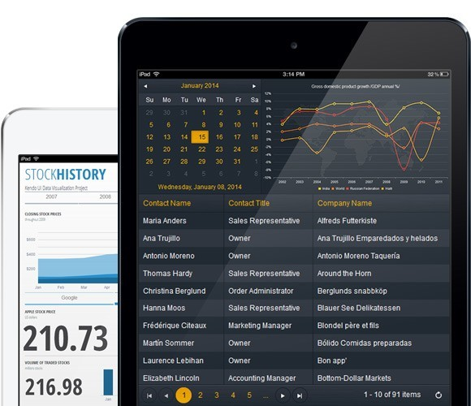


Slide 2


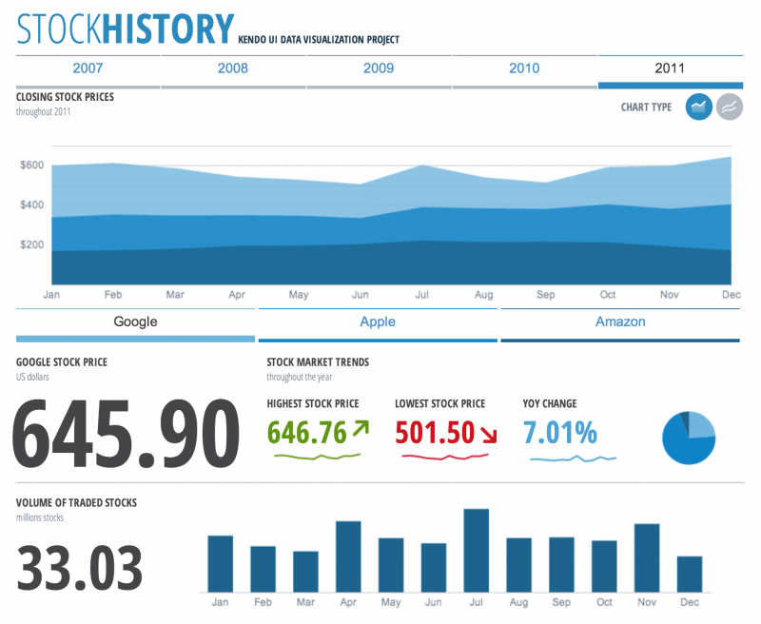


Introduction: Frameworks for “Web Designing”

Slide 3


History of Kendo UI
Bulgarian Company – Telerik established in the year 2002
Cross platform application development
Products developed by Telerik -
1). Control suites- DevCrafts (A collection of UI components and Widgets)
2). Cloud Development- Telerik platform (using SaaS)
3). Application Life Cycle Management- Team pulse (Project management tools), Test Studio (Tools for testing protocols).
Kendo UI developed in 2012.

Slide 4
Mixed patchwork of Html-5 and JavaScript with touch of
CSS-3 for styling.
Three major components in Kendo UI-
1). Kendo UI Web: Widgets for web and touch enabled
desktop environment.
2). Kendo UI Dataviz: Data Visualization widgets
3). Kendo UI Mobile: native feel for iOS, Android and
Blackberry and giving controls.

Slide 5
Features
Very good User Interface
Loads and Loads of UI component – a complete package for web designing
Working with Data Online as well as Offline
Integrated Angular JS
All kinds of Browser Support

Slide 6
How is it Better than Others?
Favourable for jQuery developers
Least External Dependency except for jQuery
Far more better way than adding libraries
Guaranteed updates every year
Many more features and widgets available

Slide 7
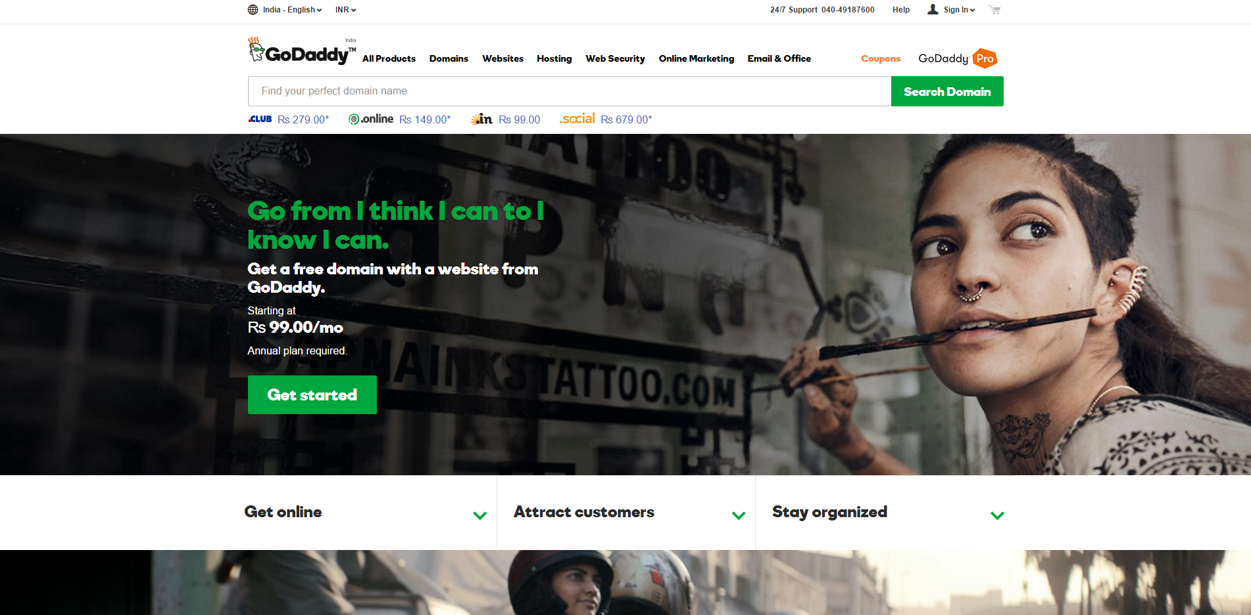
Few Websites and WebApps built on Kendo UI
Source- https://in.godaddy.com/

Slide 8
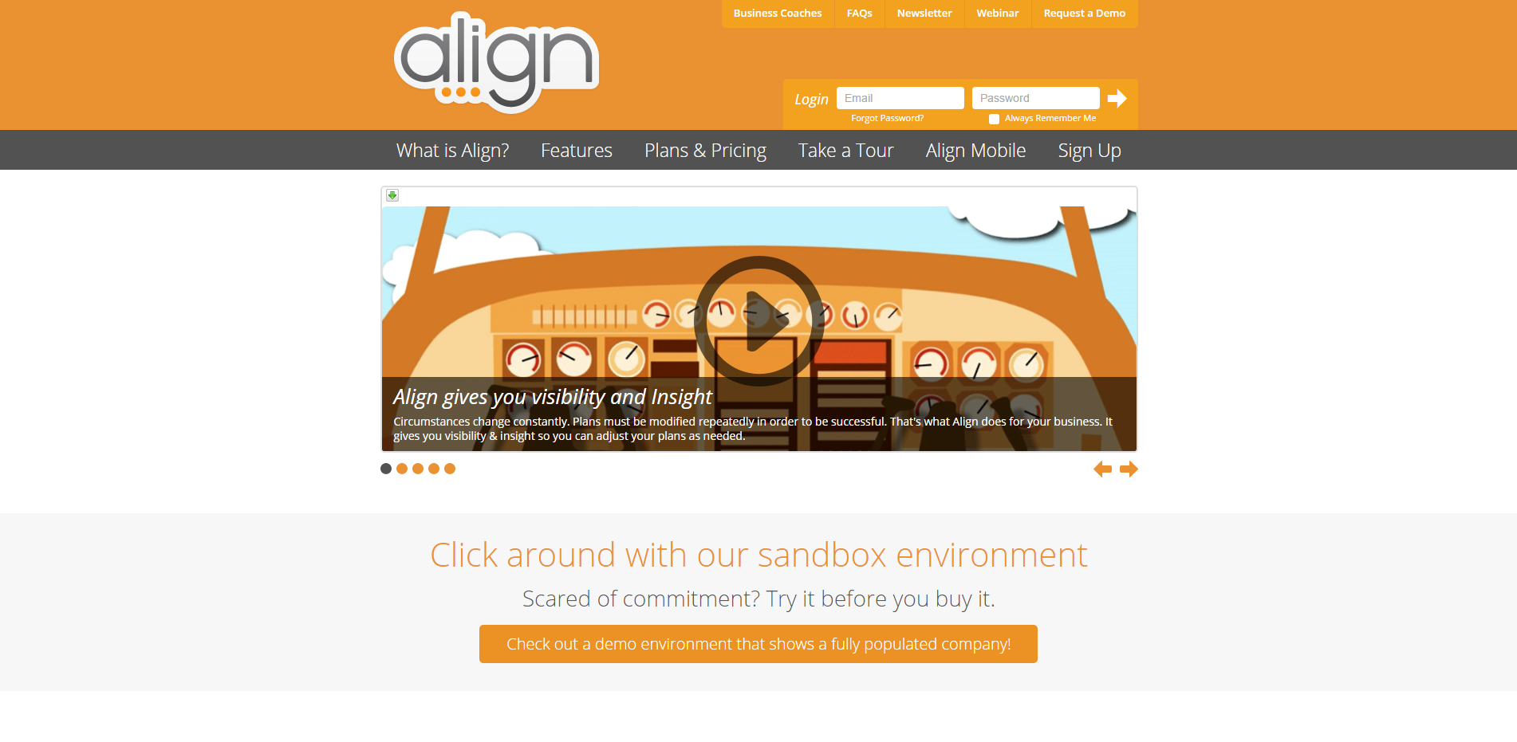
Source- https://aligntoday.com/

Slide 9
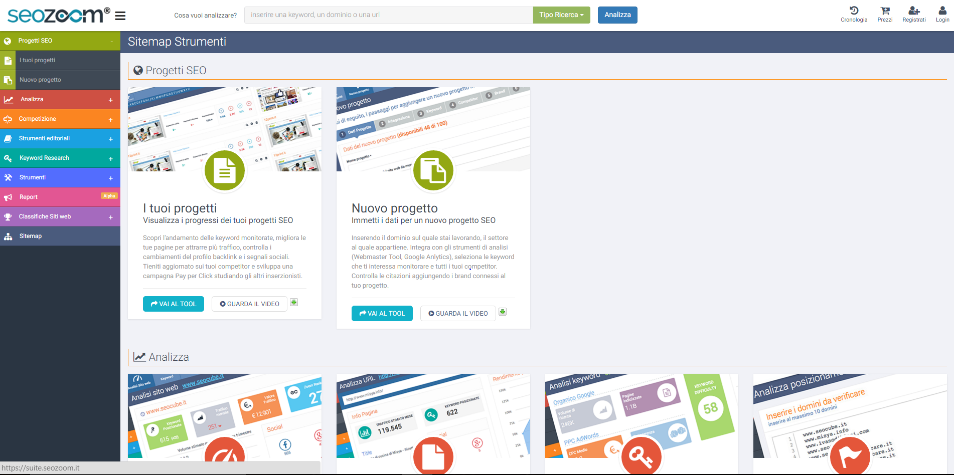
Source- https://suite.seozoom.it/

Slide 10
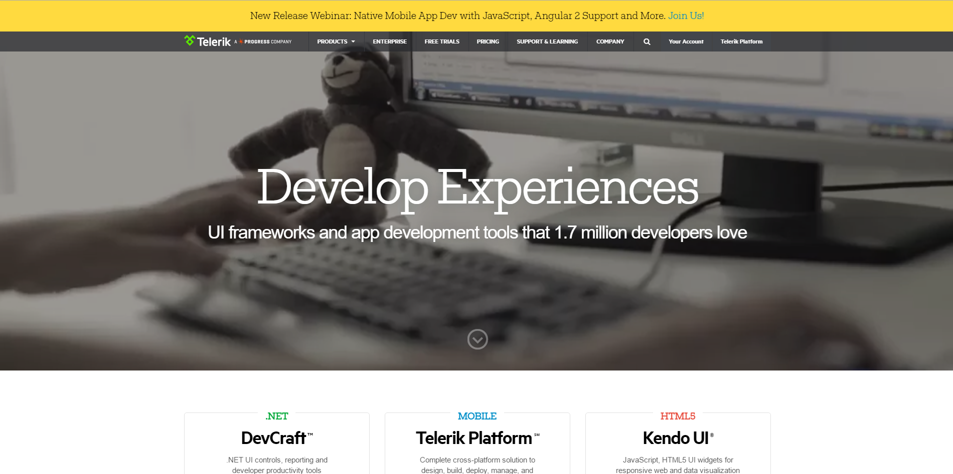
Source- http://www.telerik.com/

Slide 11
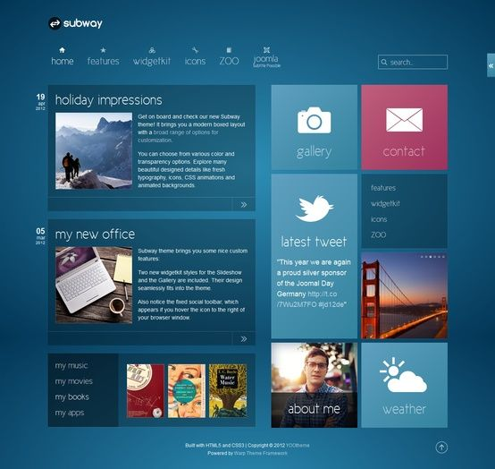
Few other Websites:
https://aligntoday.com/
https://demos.telerik.com
https://docs.telerik.com
https://pharm24.moosend.com
https://dinero.com
https://googleapps.insight.ly
https://hotslog.com
https://crm.int.godaddy.com
https://themoviedb.org
https://suite.seozoom.it
https://loginteamviewer.com

Slide 12
Limitations of using Kendo UI
Documentation of the framework
Bindings are not JavaScript
Kendo does not mangle the DOM
Mainly Kendo is not open source it costs.

